Slide 1

STUDENT PORTFOLIO
Student name: v. Vijayasanthi
Register no and NMID:24131121802522013and asanm11224131121802522013
Department:B.sc computer science
College name:Aries arts and science College
University:Annamalai University

Slide 2


PROJECT TITLE
Student portfolio

Slide 3
AGENDA
01.Problem statement
02.Project overview
03.End user
04.Tools and technologies
05.Portfolio degin and loyouts
06.Future and functionality
07.Results and screenshots
08.Conclusion
09.Github link

Slide 4

PROBLEM STATEMENT
Defines the main issue or challenge the project aims to solve, explaining why the project is necessary.

Slide 5
PROJECT OVERVIEW
A brief description of the project, including its purpose, scope, and objectives.

Slide 6
END USER
The target audience or people who will benefit from and use the project.

Slide 7
TOOLS AND TECHNOLOGIES
The software, frameworks, and programming languages used to develop the project.

Slide 8
PORTFOLIO DEGIN AND LOYOUT
The structure, style, and presentation of the project’s portfolio or interface.

Slide 9


FUTURE AND FUNCTIONALITY
Potential improvements, additional features, and scalability for the project.

Slide 10
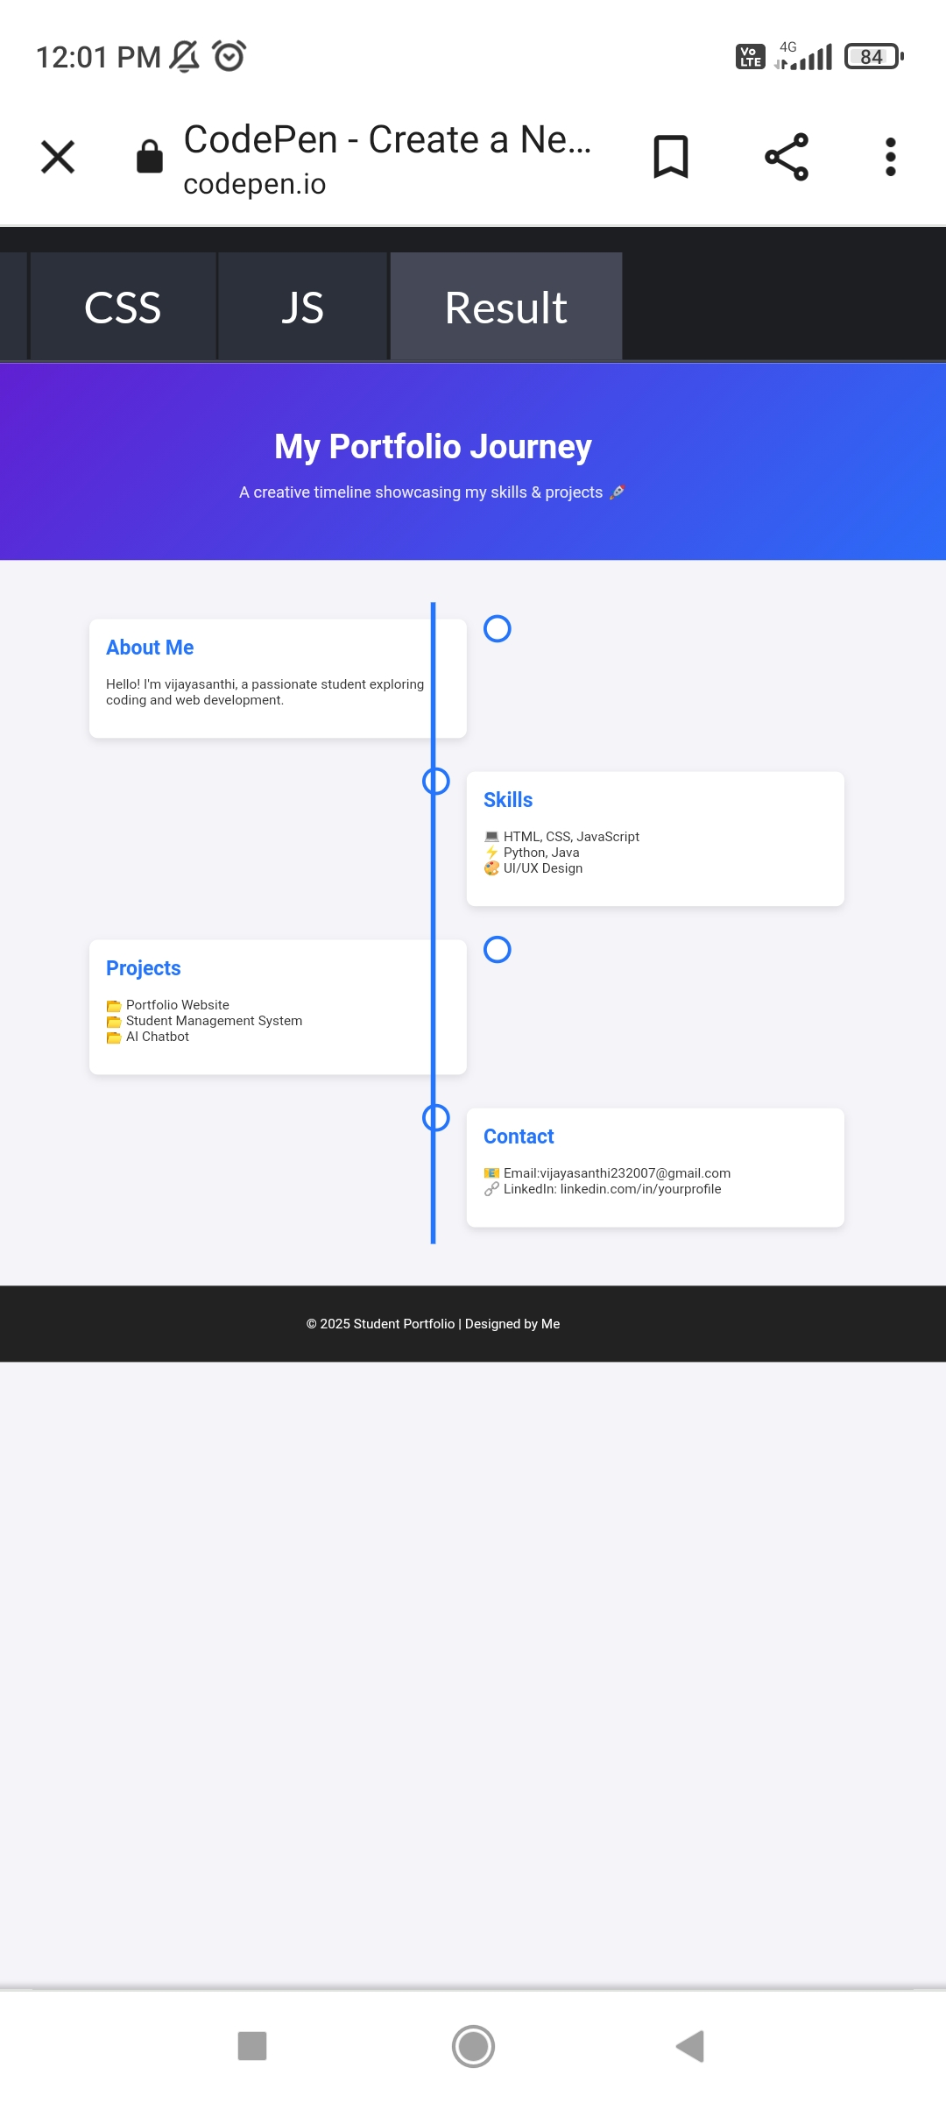
RESULTS AND SCREENSHOTS

Slide 11
CONCLUSION
Summary of the project’s achievements, learnings, and overall impact.

Slide 12
THANK YOU

